Slide 1
Binary Tree

Slide 2
Tree
A nonlinear data structure
Contain a distinguished node R, called the root of tree and a set of subtrees.
Two nodes n1 and n2 are called siblings if they have the same parent node.
Root
Subtrees
Figure: Tree

Slide 3
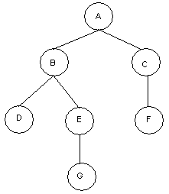
Binary Tree
A binary tree T is defined as a finite set of elements, called nodes such that:
T is empty
T contains a distinguished node R, called the root of T and the remaining nodes of T form an ordered pair of disjoint binary trees T1 and T2. T1 and T2 are called the left and right subtrees of R.
Any node N in a binary tree T has either 0, 1 or 2 successors.
Nodes with no successors are called terminal nodes or leaf nodes.
Example:
Binary Tree: T
Root: A
Nodes with 2 Successors: A, B
Nodes with 1 Successors: C, E
Terminal Nodes: D, F, G
Figure: Binary Tree T

Slide 4


Similar Binary Trees
Two binary trees are similar if they have the same structure or same shape.
Example: T1 and T2 are similar.
T1 =
T2 =
Figure: Similar Binary Trees T1 and T2.
Copy Binary Trees
Two binary trees are copies if they are similar and they have the same contents at the corresponding nodes.
Example: T1 and T3 are copies but T1 and T2 are not copies..
T1 =
T2 =
T3 =
Figure: Binary Trees T1 and T3 are Copies.

Slide 5
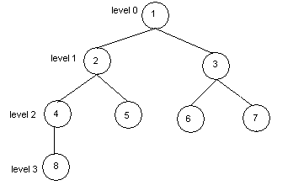
Some Basic Terms
Edge: A line from a node N of T to a successor is called is an edge.
Path: A sequence of consecutive edges is called a path.
Branch: A path from root node to a leaf node is called branch.
Level of Binary Tree: Each node in a binary tree T is assigned a level number. The root R of T has level number 0 and every other node has level number which is one more than the level number of its parent.
Depth of Binary Tree: Maximum number of nodes in a branch of T is the depth of T.
Binary Tree: T
Edge: (1, 2), (3, 6) ....
Path: (1, 2, 4), (1, 3, 6)
Branch: (1, 2, 4, 8), (1, 2, 5), (1, 3, 6), (1, 3, 7)
Depth: 4
Figure: Binary Tree T.
10/22/08

Slide 6
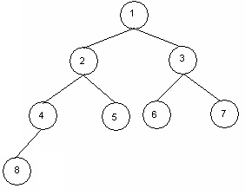
Complete Binary Trees
A binary tree T is said to be complete if all its level, except possibly the last, have the maximum number of possible nodes and if all the nodes at the last level appear as far left as possible.
The depth D_{n} of the complete binary tree with n nodes,
D_{n} =
Example:
Figure: Complete Binary Tree with Depth 4.

Slide 7
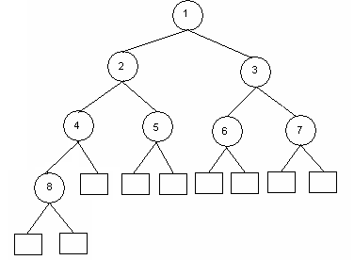
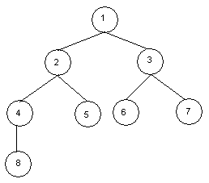
Extended Binary Tree (2-Tree)
A binary tree T is said to be an extended binary tree if each node N has either 0 or 2 children.
Nodes with 2 children are called internal nodes.
Nodes with 0 children are called external nodes.
Internal nodes are represented by circles and external nodes by squares.
Example:
Binary Tree T1
Extended Binary Tree T2
Figure: Conversion of Binary Tree into its Equivalent Extended Binary Tree

Slide 8
Representation of Algebraic Expression Using Binary Tree
Expression E = ( ( a + b ) * r + w / t ) * x
*
+
x
*
/
+
r
w
t
a
b
Figure: Binary Tree T Expressing the Algebraic Expression E.

Slide 9
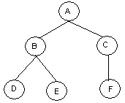
Representing Binary Tree in Memory
Let T be a binary tree. T can be represented in memory using two ways.
1. Linked Representation 2. Sequential Memory Representation
Linked Representation of Binary Tree
Use Three parallel arrays Info, Left and Right and a pointer variable Root.
Info[K]: Contains data at node N.
Left[K]: Contains location of left child of N
Right[K]: Contains location of right child of N
Root: Contains location of Root
Example:
Info
Left
Right
1
C
0
10
2
D
0
0
3
4
E
0
0
5
A
7
1
6
Root
7
B
2
4
8
9
10
F
0
0
Figure: Binary Tree T and its linked representation.
10/22/08

Slide 10
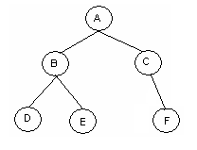
Sequential Representation of Binary Tree
Use only a single liner array Tree.
Tree[1] represents the Root of T.
If node N is in Tree[K], then its left child is in Tree[2K] and right child is in Tree[2K+1].
Tree[1] = NULL indicates T is empty.
Example:
1
2
3
4
5
6
7
8
9
10
Tree =
A
B
C
D
E
F
Figure: Binary Tree T and its sequential representation.
10/22/08

Slide 11
END!!!

